Slide 1
Threaded Binary Trees
Two many null pointers in current representation of binary trees n: number of nodes number of non-null links: n-1 total links: 2n null links: 2n-(n-1)=n+1
Replace these null pointers with some useful “threads”.

Slide 2
Threaded Binary Trees (Continued)
If ptr->left_child is null,
replace it with a pointer to the node that would be
visited before ptr in an inorder traversal
If ptr->right_child is null,
replace it with a pointer to the node that would be
visited after ptr in an inorder traversal

Slide 3
A Threaded Binary Tree
root
A
dangling
B
C
dangling
D
E
F
G
inorder traversal:
H, D, I, B, E, A, F, C, G
H
I

Slide 4
Memory Representation of A Threaded BT
root
--
f
f
f
A
f
f
B
f
f
C
f
f
D
f
t
E
t
t
F
t
t
G
t
t
H
t
t
I
t

Slide 5
Next Node in Threaded BT
threaded_pointer insucc(threaded_pointer tree)
{
threaded_pointer temp;
temp = tree->right_child;
if (tree->right_thread==FALSE)
while (temp->left_thread==FALSE)
temp = temp->left_child;
return temp;
}

Slide 6
Inorder Traversal of Threaded BT
void tinorder(threaded_pointer tree)
{
/* traverse the threaded binary tree inorder */
threaded_pointer temp = tree;
for (;;) {
temp = insucc(temp);
if (temp==tree) break;
printf(“%3c”, temp->data);
}
}
O(n)

Slide 7
Inserting Nodes into Threaded BTs
Insert child as the right child of node parent
change parent->right_thread to FALSE
set child->left_thread to TRUE and child->right_thread to parent->right thread
set child->left_child to point to parent
set child->right_child to parent->right_child
change parent->right_child to point to child
-if child->right thread == FALSE
Case 2
Then find inorder successor of child
Make left_child of inorder successor point to child

Slide 8
Examples
Insert a node D as a right child of B.
root
root
A
A
(1)
B
parent
B
parent
(3)
child
child
C
D
C
D
(2)
empty

Slide 9
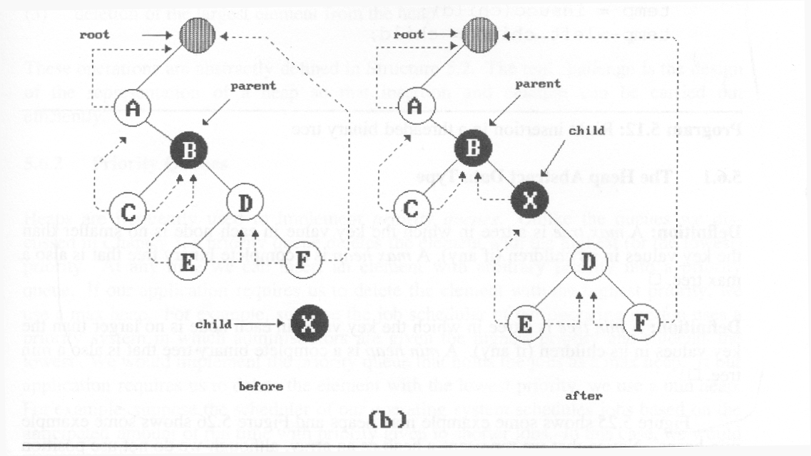
(3)
(2)
(1)
(4)
nonempty

Slide 10
Right Insertion in Threaded BTs
void insert_right(threaded_pointer parent,
threaded_pointer child)
{
threaded_pointer temp;
child->right_child = parent->right_child;
child->right_thread = parent->right_thread;
child->left_child = parent; case (a)
child->left_thread = TRUE;
parent->right_child = child;
parent->right_thread = FALSE;
if (child->right_thread==FALSE) { case (b) temp = insucc(child);
temp->left_child = child;
}
}
(1)
(2)
(3)
(4)

